Slide 1


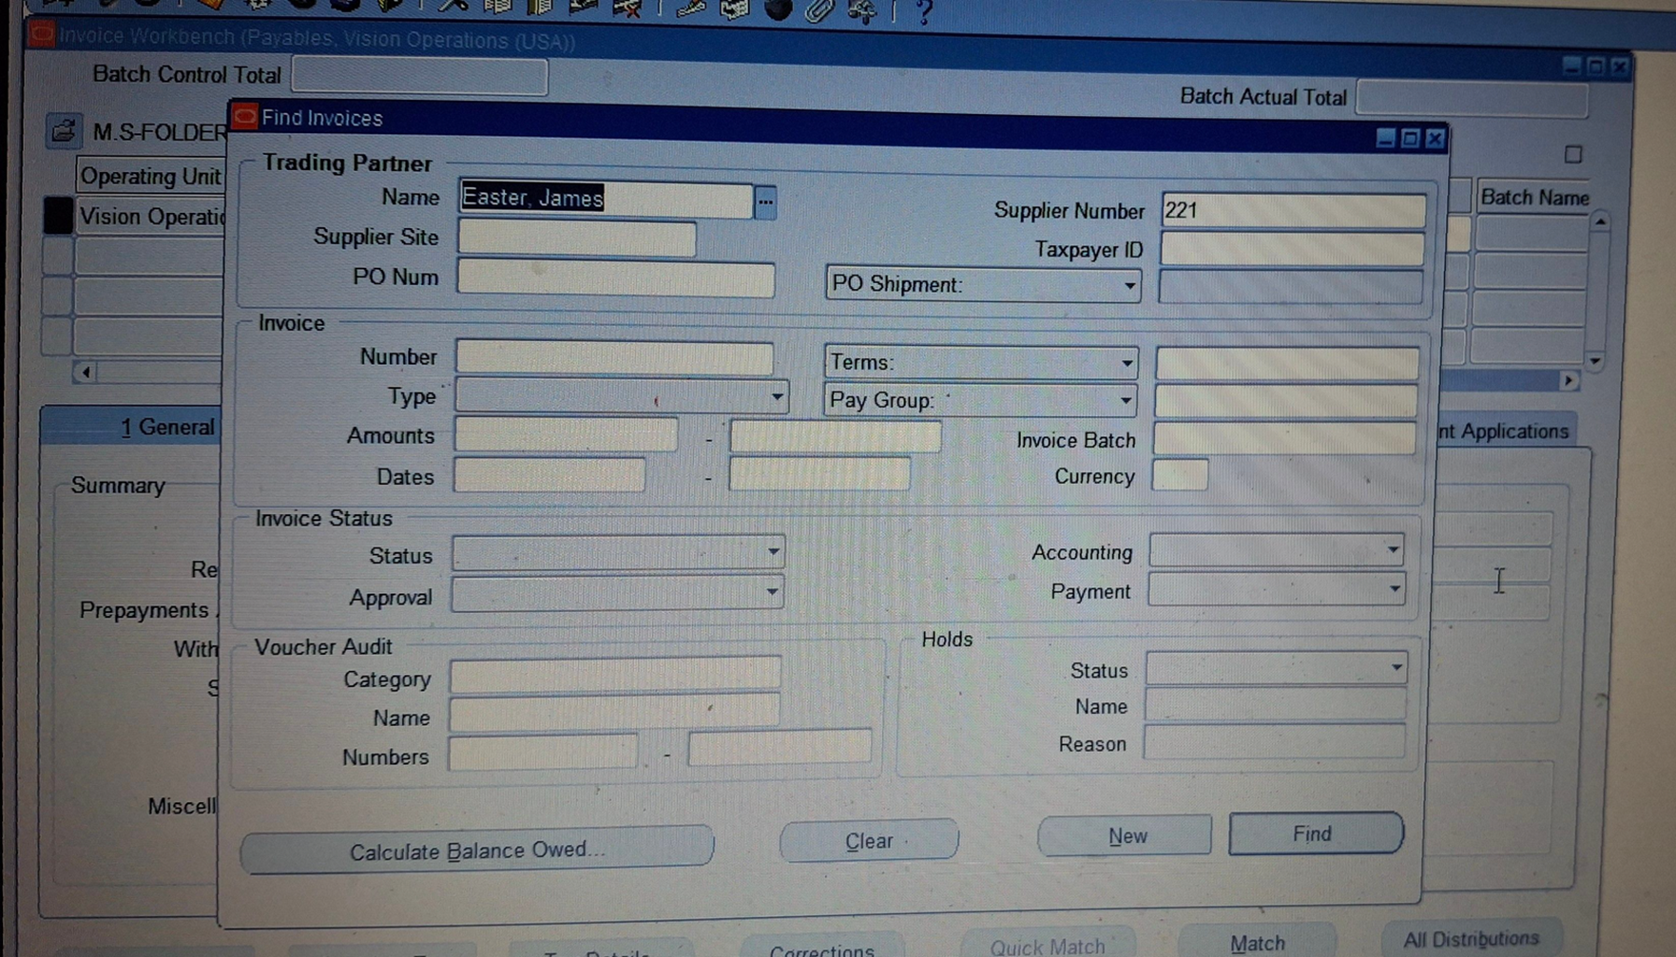
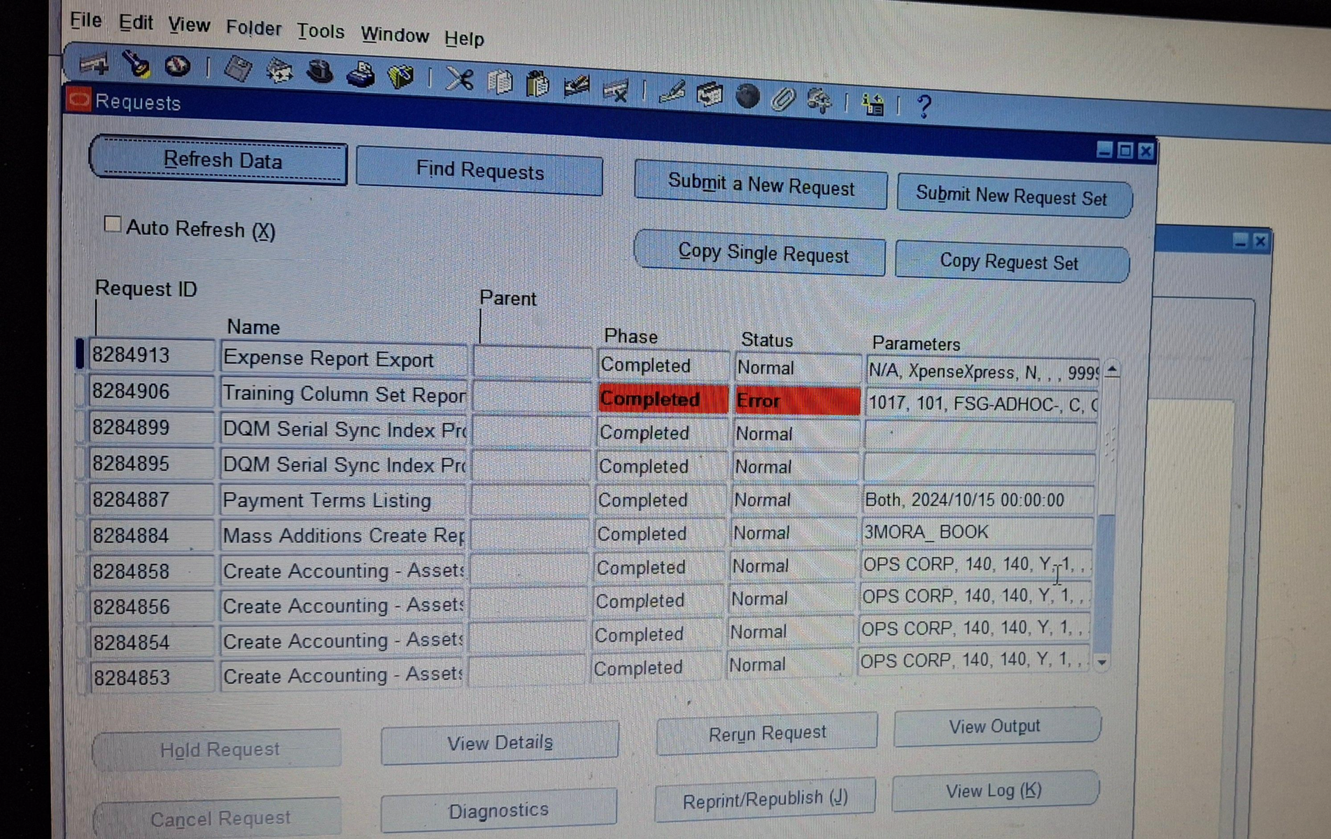
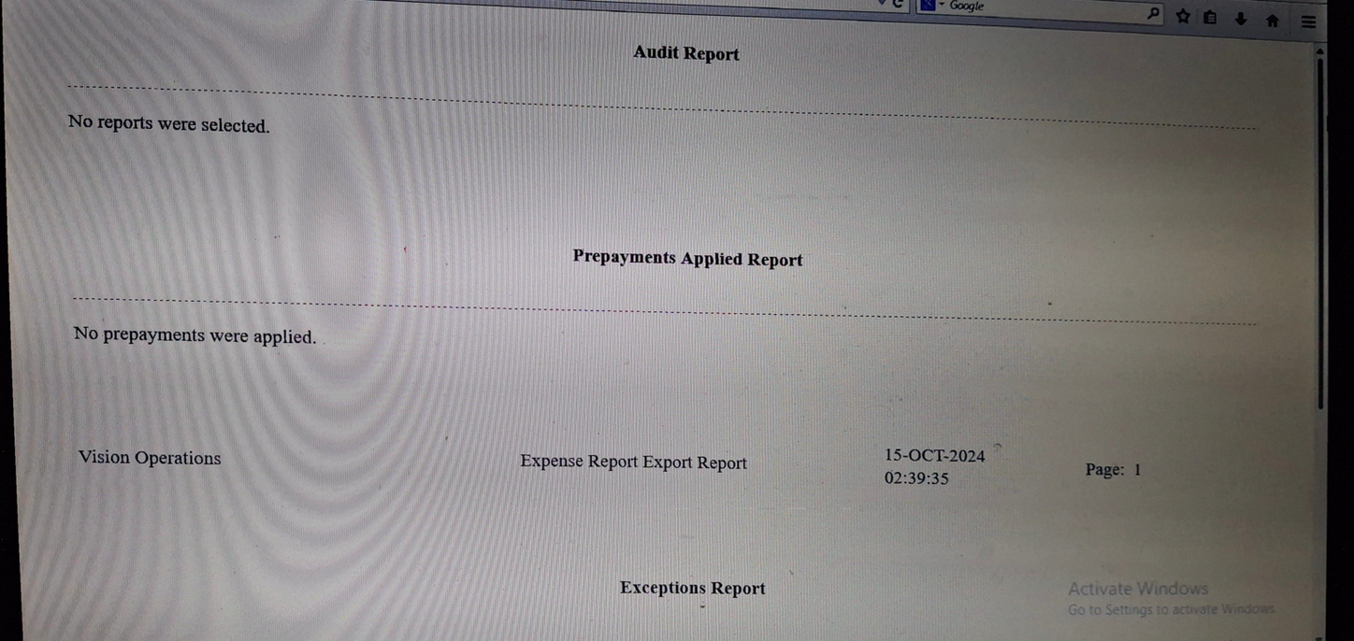
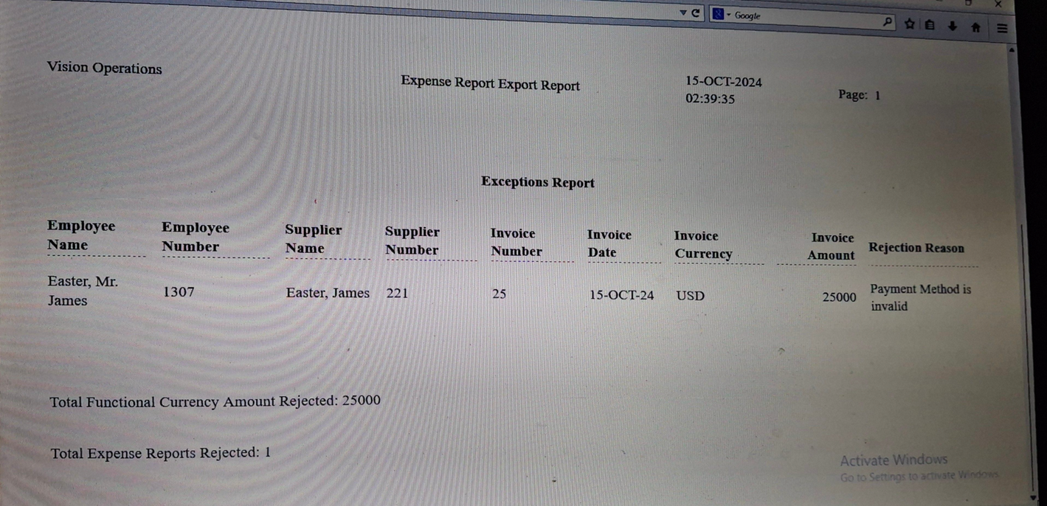
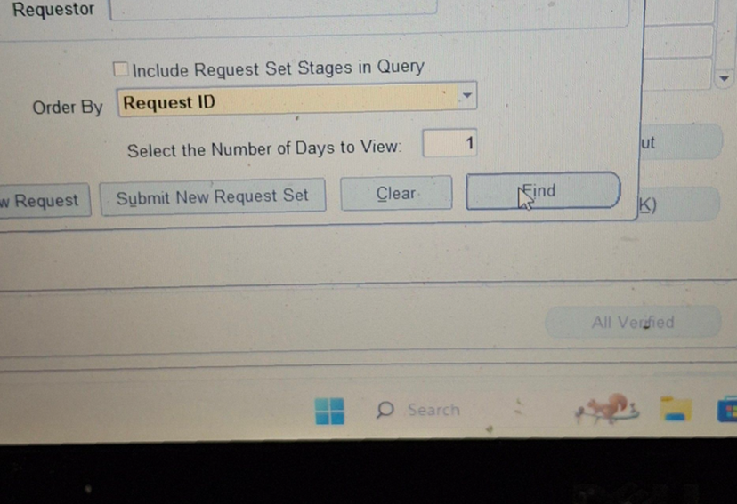
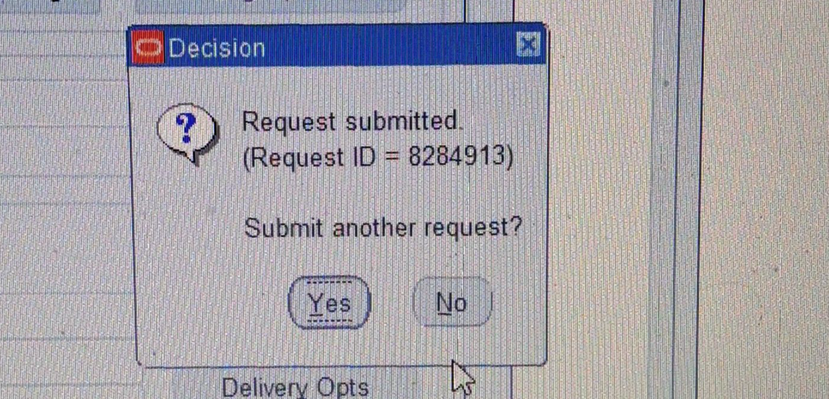
Create and Manage Supplier Invoices
Expense Report from invoice
Press OK > Submit >No
View > Request > Find > Expense Report Export
Status [Normal * Complete]​
Click View Out put
Report
Invoice > Entry > Find
▪︎Estar James **
27

Slide 2
Create and Manage Supplier Invoices
Recurring invoice
It is an invoice that is repeated monthly with the value, date and expenses that you want to make this invoice you must do some steps:
1. Distribution Set
2. Special Calendar
3. create recurring invoice
28

Slide 3
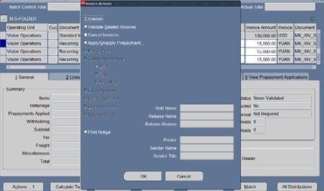
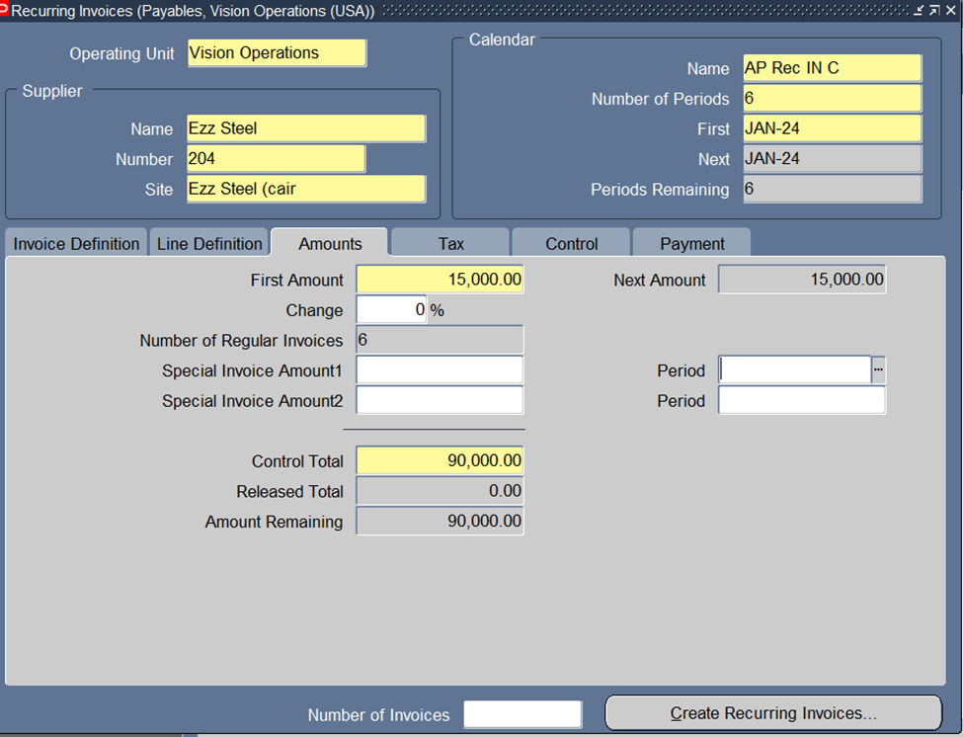
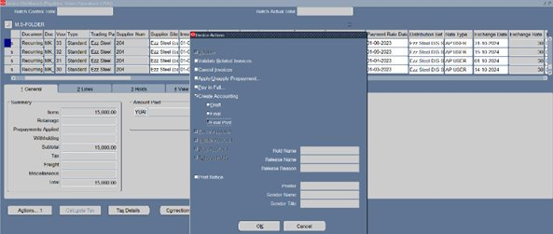
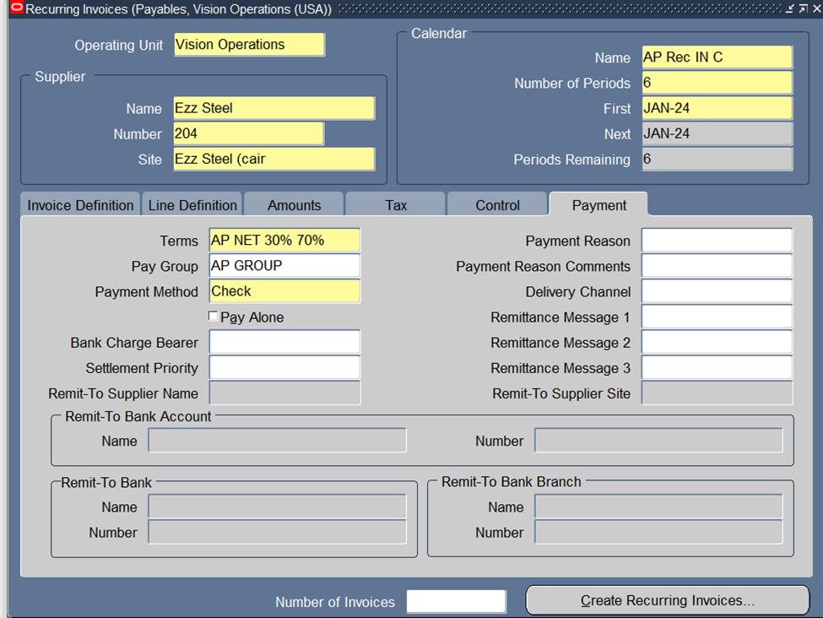
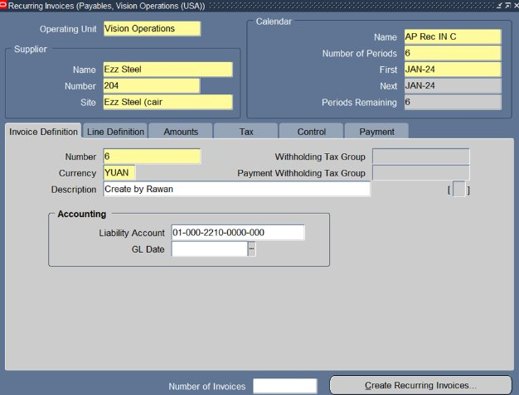
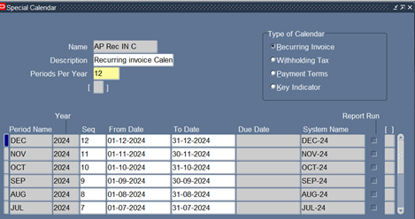
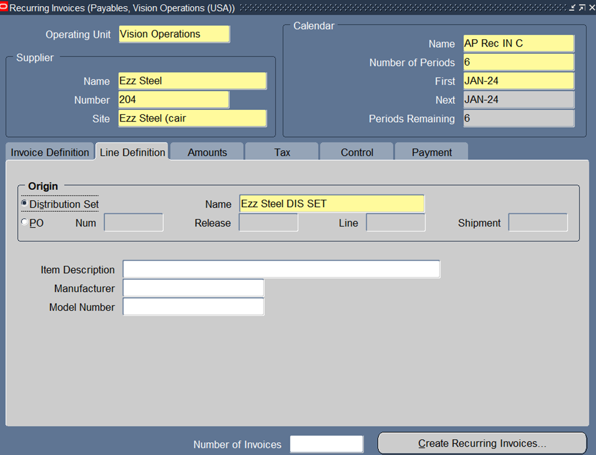
Create and Manage Supplier Invoices
2. Special Calendar
Setup > Calendar > Special Calendar
3. Create Recurring Invoices
Invoice → Entry → Recurring invoice
Click on line definition
Click on payment to choose terms , pay group and payment method
Then go to
invoices > entry > invoices
29

